Slide 1

Audio-VISUAL SPEECH RECOGNITION
GROUP MEMBERS : TEJASWI KOTTAKKI - 2010030088
HARIKA NETHI - 2010030119
SHREYA CHINTAWAR - 2010030155
AMRUTHA VARSHINI - 2010030009
GUIDE
DR.ARPITA GUPTA

Slide 2
OUTLINE
Problem statement
Motivation
Objective
Literature Survey
Dataset
Flow Diagram
Pre-Processing
Models
Conclusion
References
AUDIO-VISUAL SPEECH RECOGNITION 09-03-2022 2

Slide 3
Problem statement
Communicating with hearing-impaired people is a little more demanding than speaking to a normal person.
Speech impaired people or people having low vocal range, find it difficult to communicate, as other people might not be able to understand.
Hearing and speech impairments can affect anyone, both children and adults.
AUDIO-VISUAL SPEECH RECOGNITION 28-04-2022 3

Slide 4
MOTIVATION
Speech reading helps to improve speech perception.
Hearing impaired people rely on lip reading for understanding the speech.
Audio - Visual speech recognition could positively impact the lives of hundreds of thousands of patients with speech and hearing impairments.
AUDIO-VISUAL SPEECH RECOGNITION 09-04-2022 4

Slide 5
OBJECTIVE
Assistive technology on speech-to-text conversion.
Lip reading architecture capture visual speech recognition
Speaker recognition under noisy and unconstrained conditions
AUDIO-VISUAL SPEECH RECOGNITION 09-04-2022 5

Slide 6
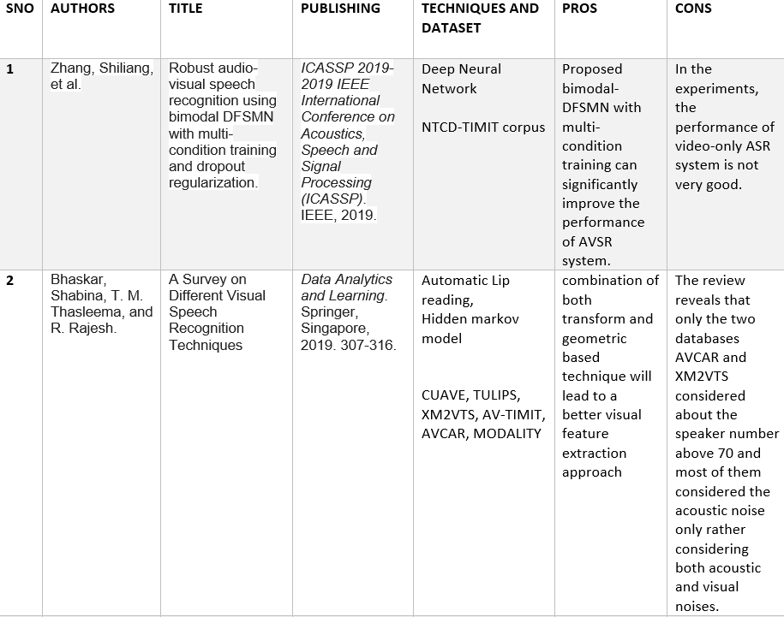
LITERATURE SURVEY
AUDIO-VISUAL SPEECH RECOGNITION 09-04-2022 6

Slide 7
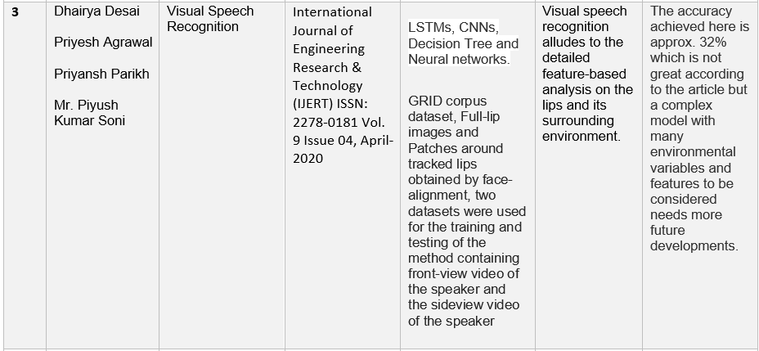
AUDIO-VISUAL SPEECH RECOGNITION 09-04-2022 7

Slide 8
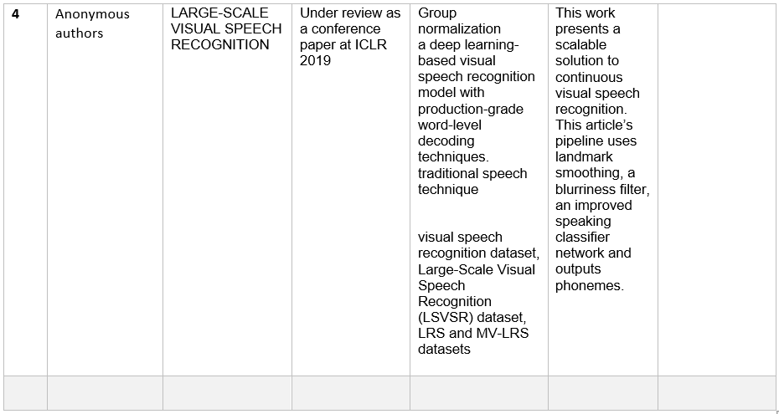
AUDIO-VISUAL SPEECH RECOGNITION 09-04-2022 8

Slide 9
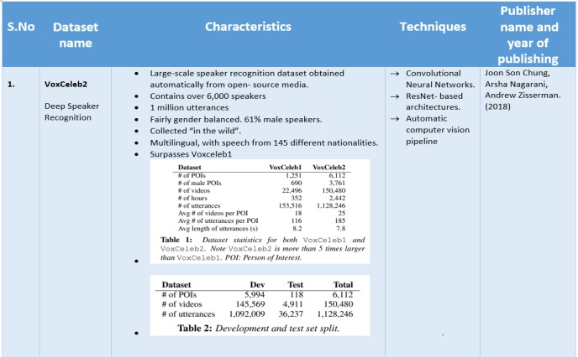
DATASET
AUDIO-VISUAL SPEECH RECOGNITION 09-04-2022 9

Slide 10
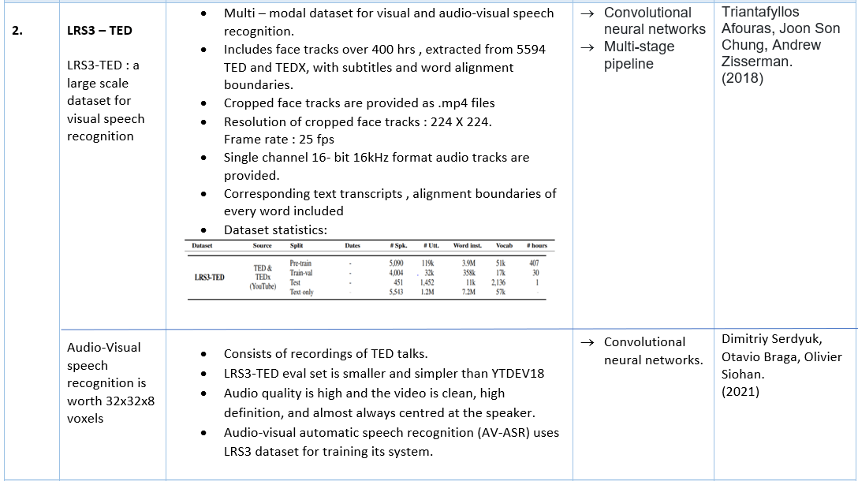
AUDIO-VISUAL SPEECH RECOGNITION 09-04-2022 10

Slide 11
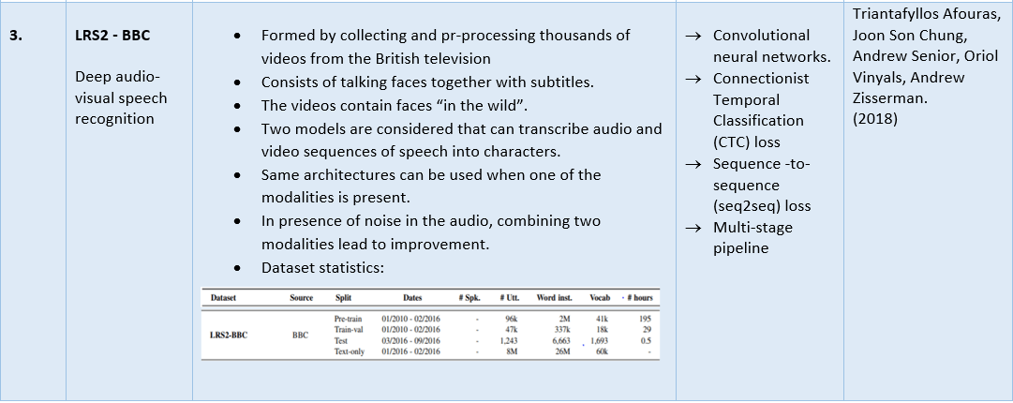
AUDIO-VISUAL SPEECH RECOGNITION 09-04-2022 11

Slide 12
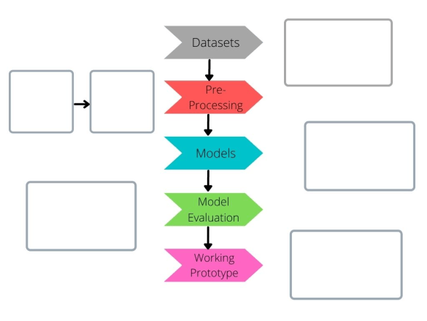
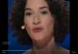
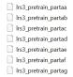
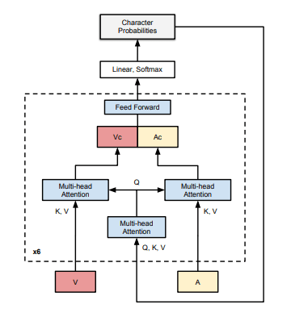
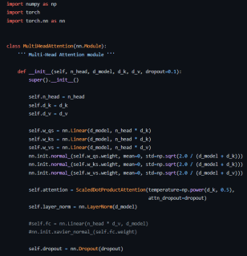

FLOW DIAGRAM
AUDIO-VISUAL SPEECH RECOGNITION 09-04-2022 12

Slide 13
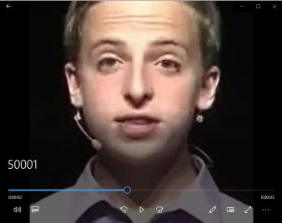
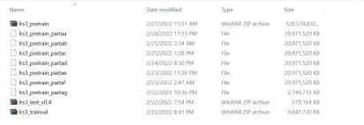
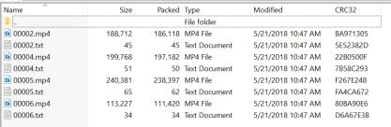
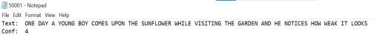
Step 1 - datasets
AUDIO-VISUAL SPEECH RECOGNITION 09-04-2022 13

Slide 14
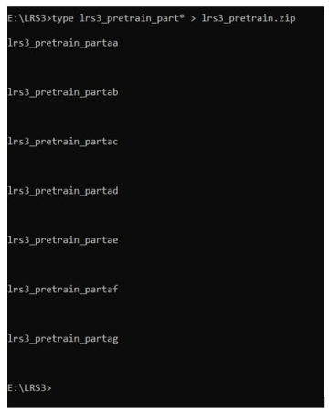
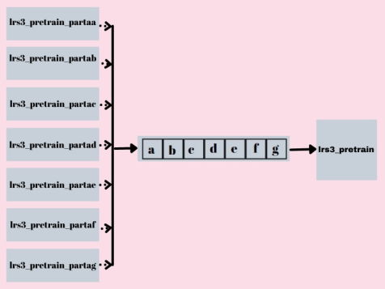
Step 2 - PRE-PROCESSING
Technique: Concatenation
AUDIO-VISUAL SPEECH RECOGNITION 09-04-2022 14

Slide 15
Step 3 - MODEL
TRANSFORMER SEQ2SEQ
AUDIO-VISUAL SPEECH RECOGNITION 09-04-2022 15

Slide 16
MODELS
Sequence to Sequence :
Sequence-to-sequence models are fundamental Deep Learning techniques that operate on sequence data. It converts sequence from one domain to sequence in another domain.
These models can be RNN-based simple encoder-decoder network or the advanced attention-based encoder-decoder RNN or the state-of-the-art transformer models.
There are many applications of sequence-to-sequence models such as — machine translation, speech recognition, text summarization, question answering, demand forecasting, and so on.
AUDIO-VISUAL SPEECH RECOGNITION 09-04-2022 16

Slide 17
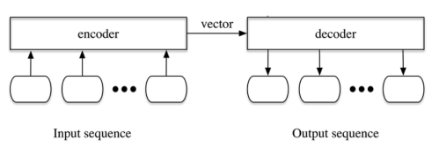
Encoder-Decoder
seq2seq is an encoder-decoder-based model that takes a sentence (sequence of words) as an input and produces another sentence as an output.
The encoder is a multiple RNN (Recurrent Neural Network) cell that can be stacked together. RNN reads the input sequentially to encode the sentence word by word and produces an output. This output is the final Hidden State (Also known as context vector), which is an encapsulated information of the input. This vector will be the input of the decoder. The decoder is also a stack of RNN cells but aims to decode the hidden state and convert it to predict an output (words).
AUDIO-VISUAL SPEECH RECOGNITION 09-04-2022 17

Slide 18
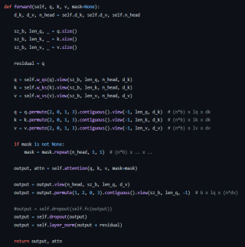
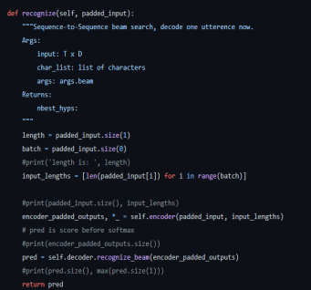
Step 4 – MODEL EVALUATION
AUDIO-VISUAL SPEECH RECOGNITION 09-04-2022 18

Slide 19
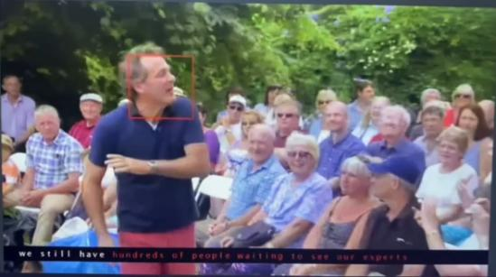
Step 5 – WORKING PROTOTYPE
AUDIO-VISUAL SPEECH RECOGNITION 09-04-2022 19

Slide 20
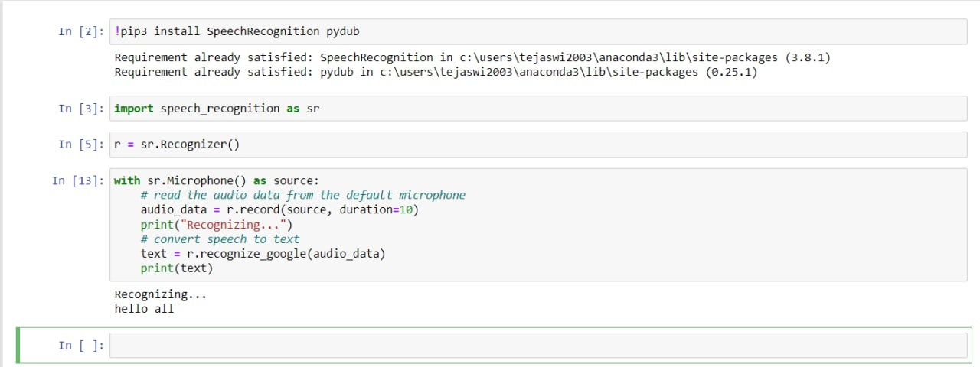
WORK PROGRESS
We’ve implemented a module for converting speech to text. Main objective of this module is to implement Speaker recognition under noisy and unconstrained conditions.
Here, the recognized text is printing in the console.
After running the program, whatever the speaker speaks in the 7 seconds of time period, the program will convert that speech to text form and print it in the console.
AUDIO-VISUAL SPEECH RECOGNITION 09-04-2022 20

Slide 21
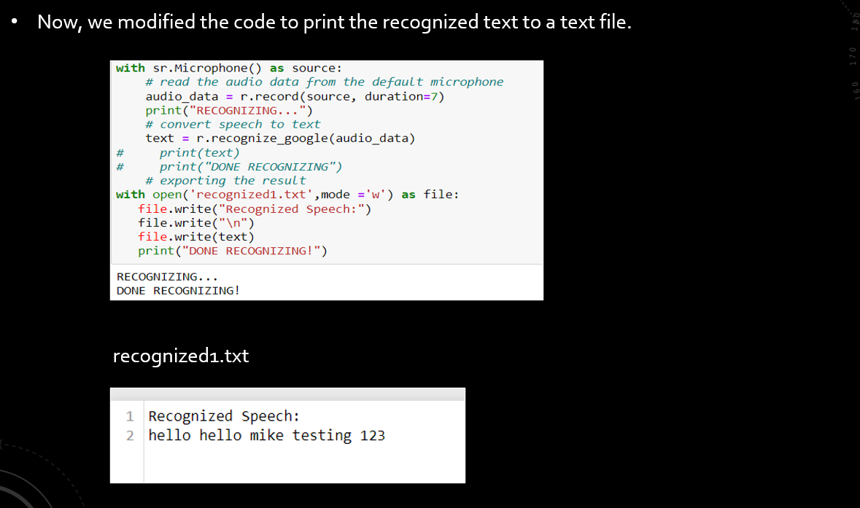
AUDIO-VISUAL SPEECH RECOGNITION 09-04-2022 20

Slide 22
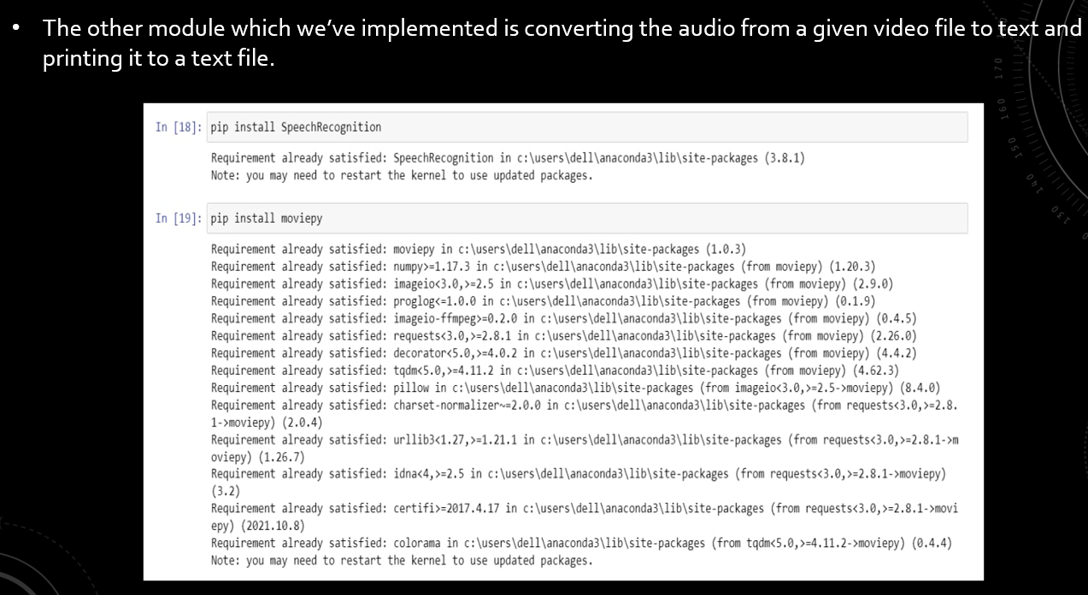
AUDIO-VISUAL SPEECH RECOGNITION 09-04-2022 21

Slide 23
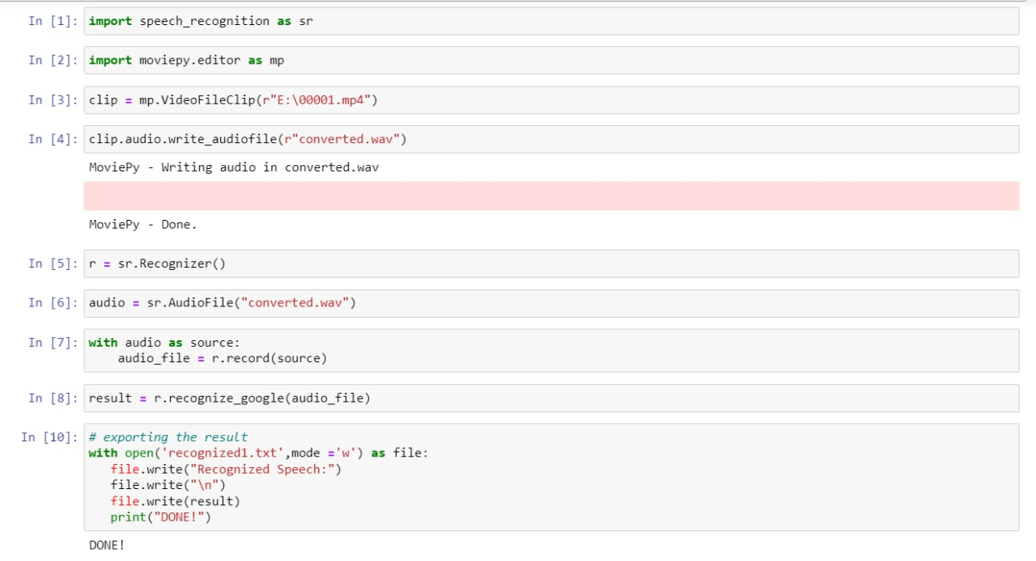
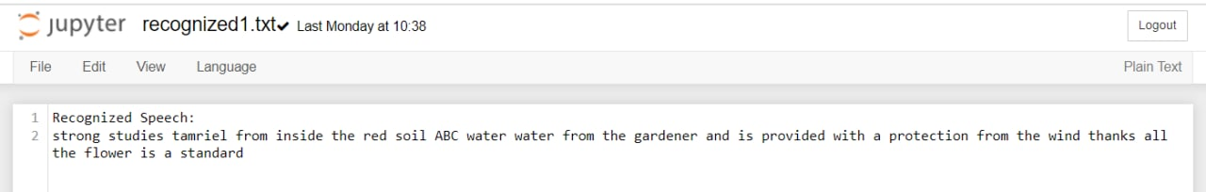
recognized1.txt
AUDIO-VISUAL SPEECH RECOGNITION 09-04-2022 22

Slide 24
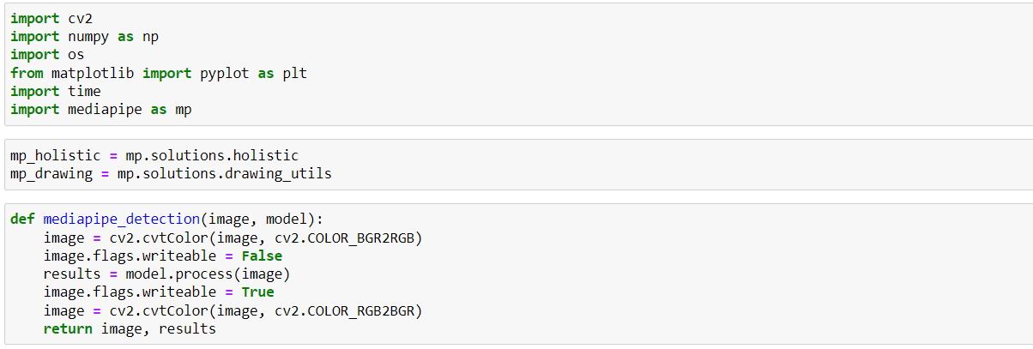
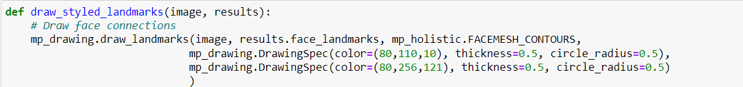
Next , we’ve implemented a module for detecting facial features.
AUDIO-VISUAL SPEECH RECOGNITION 09-04-2022 23

Slide 25
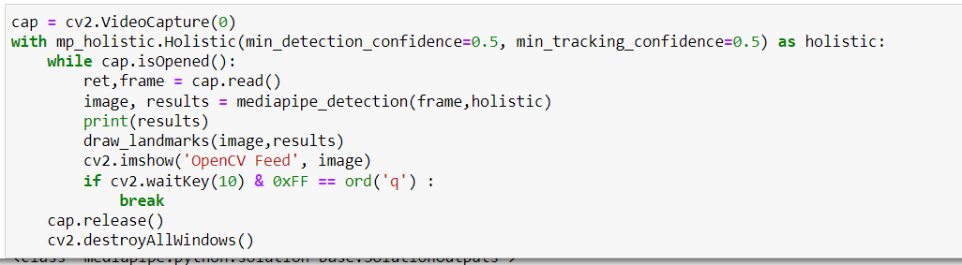
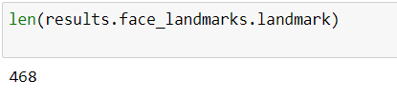
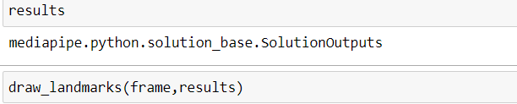
AUDIO-VISUAL SPEECH RECOGNITION 09-04-2022 24

Slide 26
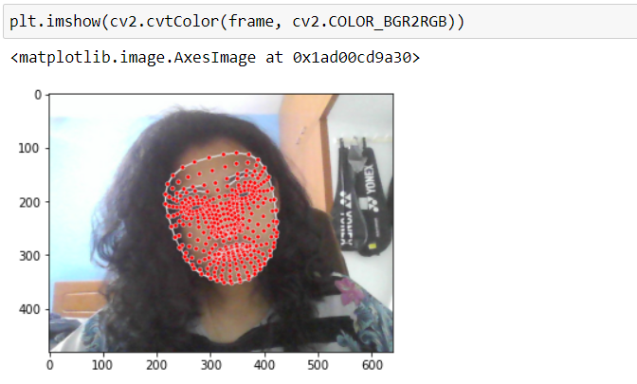
AUDIO-VISUAL SPEECH RECOGNITION 09-04-2022 25

Slide 27
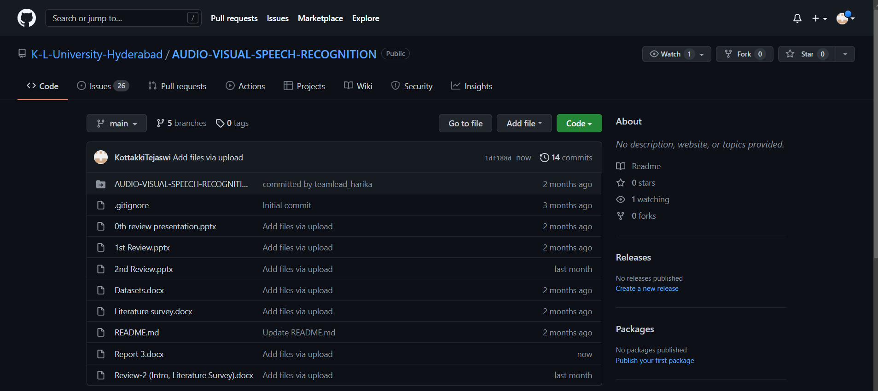
GIT-HUB COMMITS
AUDIO-VISUAL SPEECH RECOGNITION 09-04-2022 26

Slide 28
conclusion
This technology provides an alternative way of communication (i.e. Visual communication) for people with hearing or speech impaired problems.
Through this work we can recognize phrases and sentences being spoken by a talking face, with or without the audio.
We are exploring different datasets to create our own new working model.
AUDIO-VISUAL SPEECH RECOGNITION 09-04-2022 27

Slide 29
references
Zhang, Shiliang, Ming Lei, Bin Ma, and Lei Xie. "Robust audio-visual speech recognition using bimodal DFSMN with multi-condition training and dropout regularization." In ICASSP 2019-2019 IEEE international conference on acoustics, speech and signal processing (ICASSP), pp. 6570-6574. IEEE, 2019.
Bhaskar, Shabina, T. M. Thasleema, and R. Rajesh. "A Survey on Different Visual Speech Recognition Techniques." In Data Analytics and Learning, pp. 307-316. Springer, Singapore, 2019.
Desai, Dhairya, Priyesh Agrawal, Priyansh Parikh, and Mr. Piyush Kumar Soni. "Visual Speech Recognition." International Journal of Engineering Research & Technology (IJERT) 9, no. 04 (2020).
Shillingford, Brendan, Yannis Assael, Matthew W. Hoffman, Thomas Paine, Cían Hughes, Utsav Prabhu, Hank Liao et al. "Large-scale visual speech recognition." arXiv preprint arXiv:1807.05162 (2018)
AUDIO-VISUAL SPEECH RECOGNITION 09-04-2022 28

Slide 30
Chung, Joon Son, Arsha Nagrani, and Andrew Zisserman. "Voxceleb2: Deep speaker recognition." arXiv preprint arXiv:1806.05622 (2018).
Afouras, Triantafyllos, Joon Son Chung, and Andrew Zisserman. "LRS3-TED: a large-scale dataset for visual speech recognition." arXiv preprint arXiv:1809.00496 (2018).
Serdyuk, Dmitriy, Otavio Braga, and Olivier Siohan. "Audio-Visual Speech Recognition is Worth 32 x 32 x 8 Voxels." arXiv preprint arXiv:2109.09536 (2021).
Afouras, Triantafyllos, Joon Son Chung, Andrew Senior, Oriol Vinyals, and Andrew Zisserman. "Deep audio-visual speech recognition." IEEE transactions on pattern analysis and machine intelligence (2018).
AUDIO-VISUAL SPEECH RECOGNITION 09-04-2022 29

Slide 31
Afouras, Triantafyllos, Joon Son Chung, Andrew Senior, Oriol Vinyals, and Andrew Zisserman. "Deep audio-visual speech recognition." IEEE transactions on pattern analysis and machine intelligence (2018).
Afouras, Triantafyllos, Joon Son Chung, and Andrew Zisserman. "LRS3-TED: a large-scale dataset for visual speech recognition." arXiv preprint arXiv:1809.00496 (2018).
Mirzaei, Mohammad Reza, Seyed Ghorshi, and Mohammad Mortazavi. "Audio-visual speech recognition techniques in augmented reality environments." The Visual Computer 30, no. 3 (2014): 245-257.
AUDIO-VISUAL SPEECH RECOGNITION 09-04-2022 30

Slide 32
SUGGESTIONS
AUDIO-VISUAL SPEECH RECOGNITION 09-04-2022 31

